Slide 1
Business Opportunities with Green Energy in Germany
Thomas Grigoleit
Director Energy, Construction and Environment
www.gtai.com

Slide 2
Development of Renewable Energy Systems
Total capacity of renewables (End 2000)
~ 30,000 installations
Wind energy
PV
Biomass
The circle diameter is proportional to the electrical capacity
Sources: 50HertzT, TenneT, Amprion, TransnetBW, internal data
Notes:
I‘ll start with this animation because it shows the impressive development of renewable energy sytems over time.
Starting in the year 2000 when the feed-in tariff was introduced until today with about 1.8 million PV, Wind and Biomass Systems.

Slide 3
Development of Renewable Energy Systems
Total capacity of renewables (End 2005)
Total capacity of renewables (End 2000)
Total capacity of renewables (End 2005)
~ 221,000 installations
~ 30,000 installations
Wind energy
PV
Biomass
The circle diameter is proportional to the electrical capacity
Sources: 50HertzT, TenneT, Amprion, TransnetBW, internal data
Notes:
I‘ll start with this animation because it shows the impressive development of renewable energy sytems over time.
Starting in the year 2000 when the feed-in tariff was introduced until today with about 1.8 million PV, Wind and Biomass Systems.

Slide 4
Development of Renewable Energy Systems
Total capacity of renewables (End 2005)
Total capacity of renewables (End 2000)
Total capacity of renewables (End 2010)
~ 221,000 installations
~ 750,000 installations
~ 30,000 installations
Wind energy
PV
Biomass
The circle diameter is proportional to the electrical capacity
Sources: 50HertzT, TenneT, Amprion, TransnetBW, internal data
Notes:
I‘ll start with this animation because it shows the impressive development of renewable energy sytems over time.
Starting in the year 2000 when the feed-in tariff was introduced until today with about 1.8 million PV, Wind and Biomass Systems.

Slide 5
Development of Renewable Energy Systems
Total capacity of renewables (End 2005)
Total capacity of renewables (End 2000)
Total capacity of renewables (End 2010)
Total capacity of renewables (2020)
~ 221,000 installations
~ 750,000 installations
> 1.8 million installations
~ 30,000 installations
Wind energy
PV
Biomass
The circle diameter is proportional to the electrical capacity
Sources: 50HertzT, TenneT, Amprion, TransnetBW, internal data
Notes:
I‘ll start with this animation because it shows the impressive development of renewable energy sytems over time.
Starting in the year 2000 when the feed-in tariff was introduced until today with about 1.8 million PV, Wind and Biomass Systems.

Slide 6
Renewable Electricity in Germany
50.2% H1 2020
Chart shows renewable share of gross electricity consumption and goals according to the Germany Energy Concept 2010 and 2017
Source: BMWi, 2019 and BDEW, 2020

Slide 7
Germany’s Exit from Coal Power
No coal by 2038 at the latest
Based on chart by Felix Chr. Matthes, Öko-Institut * Installed capacity according to Coal Exit Law (KVBG) in GW at end of respective year

Slide 8
The Energiewende is Germany’s effort to reduce greenhouse gas emissions without relying on nuclear energy.
This means transforming electricity generation, buildings, industry, transportation, agriculture, and more.
Notes:
Energieeffiency 2050 goal:
-50% compared to 2008
RENEWABLE Energy in Electricity 2050 goal:
share of 80%
Renewable share in final energy consumption will rise to 60% by 2050
Plus: Nuclear Phase Out and Now Coal Phase out

Slide 9
Future Offshore Wind Development – 40 GW in 2040
Annual Additions (in MW)
Cumulative Capacity (in MW)
Sources: Deutsche WindGuard, 2020, BMWi 2020

Slide 10
Pillars of the Market Transformation
H₂
Energy efficiency and reduction of the energy demand
Electrification and development of renewable electricity
Development of hydrogen as energy carrier and feedstock
Source: Agora Energiewende, Klimaneutrales Deutschland 2050

Slide 11
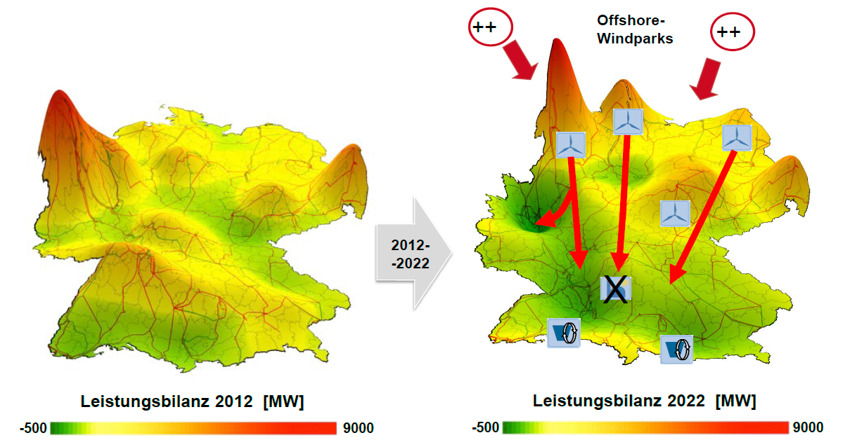
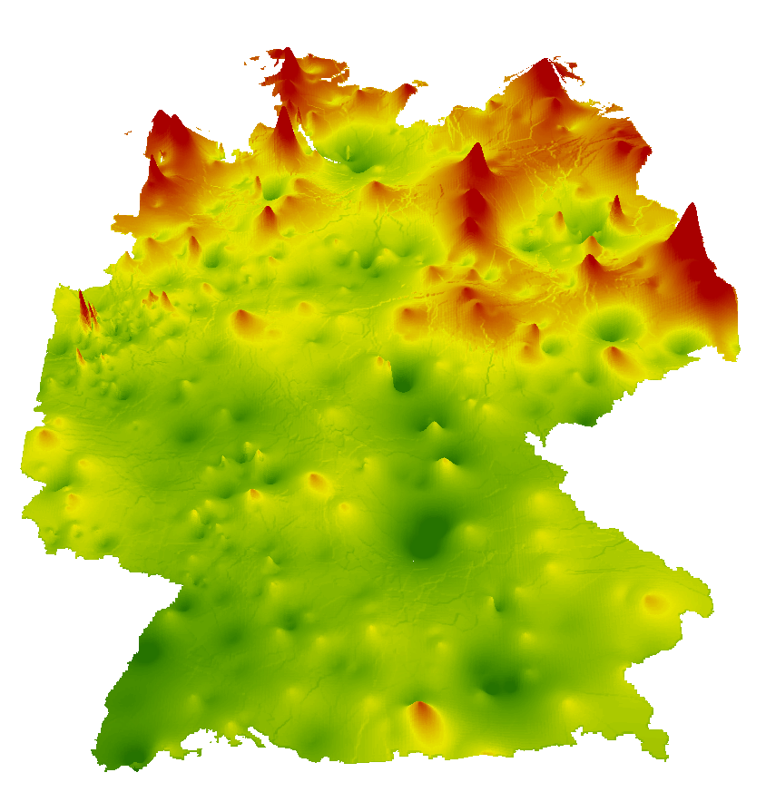
Changing Power Structure
[MW]
2014-2024
[MW]
[MW]
Power balance 2014
Power balance 2024
Source: Bundesnetzagentur 2016
Notes:
11
We need to transport
11GW Coal exit not included
Build new power lines from north to south
60 bn until 2030
Out of it 30 bn for DC lines
10 bn offshore connections
2017 and 2018 More than 5 TWh was curtailed because of bottlenecks

Slide 12
Smart Meter Roll-Out – a chance for innovative technologies, new business models & flexible tariffs
Customer approval for flexible tariffs
In % of respondents in Germany, 2019
22 %
62 %
Source: Bitkom, 2020

Slide 13
2020: EV Market Takes Off - Charging Infrastructure Following
Electric vehicles (PHEV + BEV) vs. public charging stations
(Number of units, 2011 – 2020)
Growth in the EV market causes demand for charging stations – potentially equipped with batteries and smart grid technologies
Source: IEA 2018, 2019

Slide 14
Germany’s Energy Market Will Look Different By 2035
2035*
2035*
2035*
18
2020
12
60
2020
46
2020
2.3
Renewable share of electricity in %
0.7
GW installed battery storage**
2035*
Million
Electric Vehicles
2035*
50
2035*
>1
2020
2020
5
2020
6
1.1
0.04
Million
Heat pumps
Million
Smart Meters
Million
EV Charging Stations
Source: BNetzA, 2021* Prognosis Scenario B Netzentwicklungsplan,**PV & industrial battery storage systems. Graph: GTAI

Slide 15
Germany’s National Hydrogen Strategy
Invest EUR 9 billion: EUR 7 billion nationally + EUR 2 billion internationally
5 GW of electrolysis generation capacity till 2030, another 5 GW till 2035, latest 2040
Develop a policy framework that encourages investments
37 measures to ramp up hydrogen market:
from generation to utilization
industry, heating, mobility, infrastructure
Hydrogen will become central pillar in achieving Germany’s energy transition
Notes:
The water industry faces a variety of challenges in the future.
Construction of new plants for sewage sludge disposal and the guarantee of an innovative phosphorus recovery
Improving energy efficiency in waste water treatment plants
Improving the cleaning performance of wastewater treatment plants to include micro pollutants
Adaptation of plants to climate change (e.g. heavy rain events or droughts)
Regular maintenance and replacement investments in the networks also against the background of demographic change in many regions of Germany
Digitalization of the water industry
The challenges will require innovative technology and high investments in water management systems. GTAI is here to support your expansion to Germany.

Slide 16
The Economic Development Agency of Germany

Slide 17
Get in touch!
Thomas.grigoleit@gtai.com
Tel.: +49 30 2000 99 224

